Slide 1

/PLAYWRIGHT PROJECT
Using OrangeHRM website as a demo.
BY: LAILA / AZWAN / EQAL
Notes:
Hello everyone, we are from group 1 which consist of Laila, Azlan, Eqal and we will presenting about Playwright Project.
We use OrangeHRM website as our demo.

Slide 2
/TABLE OF CONTENTS
/01
/INTRODUCTION
/02
/FEATURES
/03
/TEST CASES
About playwright
Prerequisite, installation, code structure.
/04
/REPORTS
Run test cases, Coding used
Test cases reports
INDEX.HTML
Notes:
For this presentation we will talk about What is Playwright? Its features? How to run the test cases? And the test cases reports

Slide 3
/01
/Introduction
INDEX.HTML

Slide 4
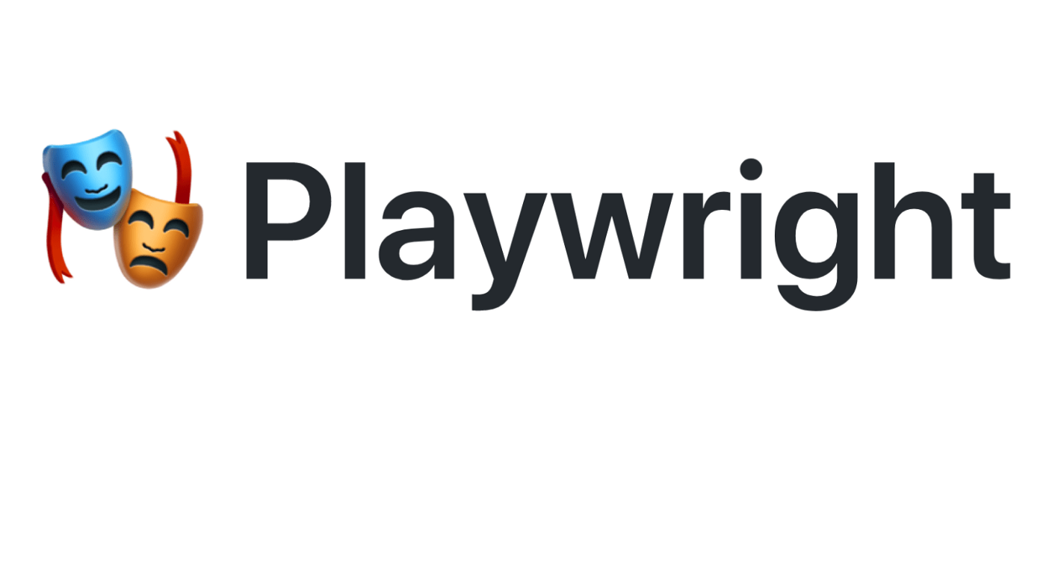
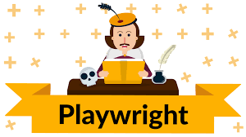
/What is Playwright?
Playwright is the cross-browser automation framework for end-to-end testing that is built on top of Puppeteer.
It is created by the Puppeteer creators and is maintained by Microsoft.
INDEX.HTML
Notes:
Puppeteer a company from google
Microsoft hired this team to develop and maintain playwright
The majority of the Application Programming Interface (API) of the playwright and everything, they have the common AP for the different browser and then it is very much like Puppeteer but more advanced and enhanced version.

Slide 5
/Why Playwright?
Playwright makes test authoring more readable, fast and reliable.
INDEX.HTML
Notes:
Most of us have worked on web automation at some point of time in our career. The common challenges we face while automating are slowness of test execution, unreliable wait scenarios, the need to write a lot of boiler-plate code for browser setup, and parallel execution, etc. The playwright tries to address these issues and makes test authoring more readable, fast and reliable

Slide 6
/CONCEPTS (Any Browser.Any Platform. One API)
/CROSS-BROWSER
/CROSS-PLATFORM
/CROSS-LANGUAGE
Chromium
WebKit
Firefox
Windows
Linux
macOS
JavaScript
TypeScript
Python
Java
.NET
INDEX.HTML
Notes:
Any browser • Any platform • One API
Cross-browser. Playwright supports all modern rendering engines including Chromium, WebKit, and Firefox.
Cross-platform. Test on Windows, Linux, and macOS,
Playwright works with some of the most popular programming languages, including JavaScript
Cross-language. Use the Playwright API in TypeScript, JavaScript, Python, .NET, Java.

Slide 7
/CAPABILITIES
/Resilient (No Flaky Test)
/No Trade-Offs (No Limits)
/Full Isolation (Fast Execution)
/Powerful Tooling
Auto-wait
Web-first assertions
Tracing
Multiple everything
Trusted events
Browser contexts
Log in once
Codegen
Playwright inspector
Trace viewer
INDEX.HTML

Slide 8
/Resilient (No Flaky Test)
Auto-wait: Playwright waits for element to be actionable prior to performing actions. It also has richest of introspection events.
Web-first assertions: Playwright assertions are created specifically for the dynamic web.
Tracing: Configure test retry strategy, capture execution trace, videos, screenshots to eliminate flakes.
INDEX.HTML
Notes:
Auto-wait. Playwright waits for elements to be actionable prior to performing actions. It also has rich set of introspection events. The combination of this two eliminate the need for artificial timeouts - primary cause of flaky tests.
Web-first assertions. Playwright assertions are created specifically for the dynamic web. Checks are automatically retried until the necessary conditions are met
Tracing. Configure test retry strategy, capture execution trace, videos, screenshots to eliminate flakes.

Slide 9
/No Trade-Offs (No Limits)
Multiple everything: Test scenarios that span multiple tabs, multiple origins and multiple users. Create scenarios with different contexts for different users and run against your server, all in one test.
Trusted events: Hover elements, interact with dynamic controls and produce trusted events.
INDEX.HTML
Notes:
Browsers run web content belonging to different origins in different processes. Playwright is aligned with the modern browsers architecture and runs tests out-of-process. This makes Playwright free of the typical in-process test runner limitations.
Multiple everything. Test scenarios that span multiple tabs, multiple origins and multiple users. Create scenarios with different contexts for different users and run them against your server, all in one test.
Trusted events. Hover elements, interact with dynamic controls, produce trusted events. Playwright uses real browser input pipeline indistinguishable from the real user.

Slide 10
/Full Isolation (Fast Execution)
Browser Contexts: Playwright creates a browser context for each test. Browser context is equivalent to a brand new browser profile.
Log in once: Save the authentication state of the context and reuse it in all the tests.
INDEX.HTML
Notes:
Browser contexts. Playwright creates a browser context for each test. Browser context is equivalent to a brand new browser profile. This delivers full test isolation with zero overhead. Creating a new browser context only takes a handful of milliseconds.
Log in once. Save the authentication state of the context and reuse it in all the tests. This bypasses repetitive log-in operations in each test, yet delivers full isolation of independent tests.

Slide 11
/Powerful Tooling
Codegen: Generate tests by recording your actions. Save them into any language.
Playwright inspector: Inspect page, generate selectors, step through the test execution, see slick points and explore execution logs.
Trace viewer: Capture all the information to investigate the test failure. Playwright trace contains test execution screencast, live DOM snapshots, action explorer, test source and many more.
INDEX.HTML
Notes:
Codegen. Generate tests by recording your actions. Save them into any language.
Playwright inspector. Inspect page, generate selectors, step through the test execution, see click points and explore execution logs.
Trace Viewer. Capture all the information to investigate the test failure. Playwright trace contains test execution screencast, live DOM snapshots, action explorer, test source and many more.
DOM is Document Object Model

Slide 12
/PLAYWRIGHT TEST
Playwright Test is a test library or test runner for playwright to extend its capabilities.
Users don’t need to declare functions for open/close tab and browser for every test case.
It uses expect for assertions and provides spec functions “it,describe etc” for automating tests.
HTML report can be obtained in node.js without need to install any additional package.
In other words, Playwright Test helps end-to-end test process more convenient.
INDEX.HTML

Slide 13
<WHOA!>
It’s a node.js library and built for a highly reactive modern web application, which makes tests written using this framework, faster, capable and reliable.
INDEX.HTML

Slide 14
/02
/Features
INDEX.HTML

Slide 15
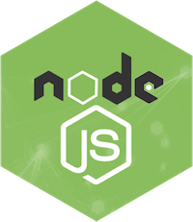

<PREREQUISITES>
INDEX.HTML

Slide 16
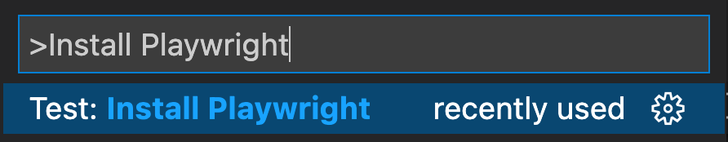
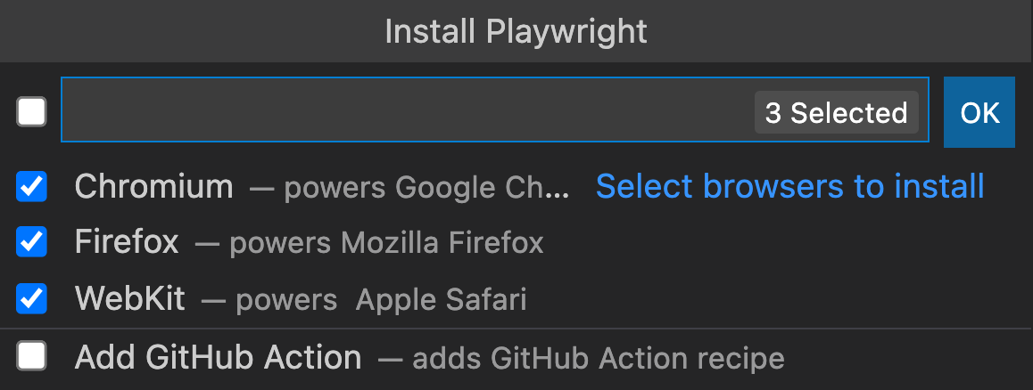
/PLAYWRIGHT INSTALLATION (Using VS code extension)
Using the code extension (pressing Ctrl+Shift+P)
Pick browsers
INDEX.HTML

Slide 17
/PLAYWRIGHT INSTALLATION (Manual)
//install playwright test
$ npm i -D @playwright/test
//install supported browser
$ npx playwright install
//.xlsx file reader
$ npm install xlsx
INDEX.HTML

Slide 18

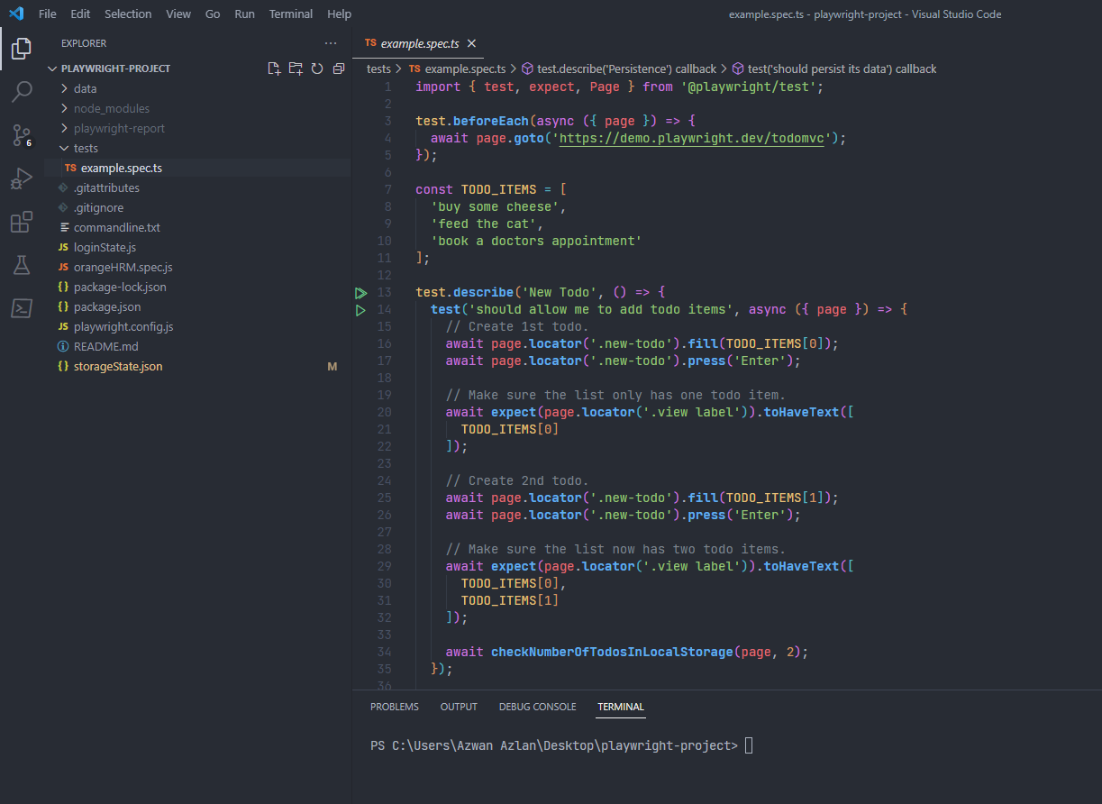
Example.spec.ts and testing tab will appear after playwright/Test has installed.
INDEX.HTML

Slide 19
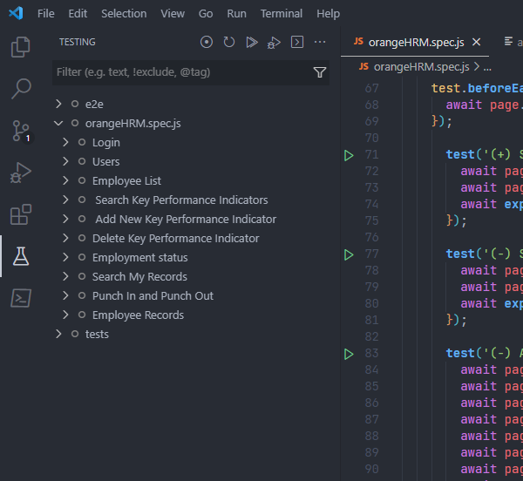
Test sidebar also will appear in VS Code after playwright/Test has successfully installed
INDEX.HTML

Slide 20
/PLAYWRIGHT TEST STRUCTURE
/Configuration File
/Test File
e.g. playwright.spec.ts
/Test Fixtures
/Test Hooks
/Test Functions
/Test
Callback
/Selectors & Actions
/Assertions
INDEX.HTML

Slide 21

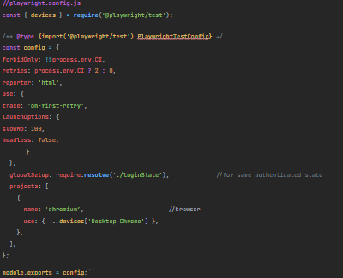
/Configuration File
INDEX.HTML

Slide 22
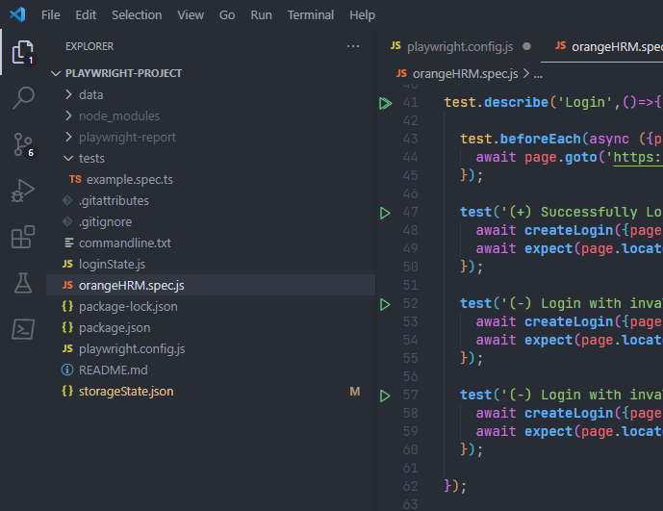
/Test File
Test file is a file that has .spec syntax on its name. E.g. playwright.spec.js
INDEX.HTML

Slide 23
/Test Fixtures
Fixtures are objects that are created for each test run.
Playwright Test comes loaded with those fixtures, and you can add your own fixtures as well.
When running tests, Playwright Test looks at each test declaration, analyses the set of fixtures the test needs and prepares those fixtures specifically for the test.
INDEX.HTML

Slide 24
/Test Fixtures
You noticed an argument { page } from the code the test files has access to:
const { webkit } = require('playwright'); // Or 'chromium' or 'firefox'. (async () => { const browser = await webkit.launch(); const context = await browser.newContext(); const page = await context.newPage(); await browser.close(); })();

Slide 25
/Test Hook
You can use test.beforeAll and test.afterAll hooks to set up and tear down resources shared between tests.
And you can use test.beforeEach and test.afterEach hooks to set up and tear down resources for each test individually
// example.spec.js const { test, expect } = require('@playwright/test'); test.describe('feature foo', () => { test.beforeEach(async ({ page }) => { // Go to the starting url before each test. await page.goto('https://playwright.dev/'); }); test('my test', async ({ page }) => { // Assertions use the expect API. await expect(page).toHaveURL('https://playwright.dev/'); }); });
INDEX.HTML

Slide 26
/Test Functions
Declares a test
test(title, testFunction)
const { test, expect } = require('@playwright/test'); test('basic test', async ({ page }) => { await page.goto('https://playwright.dev/’); const name = await page.innerText('.navbar__title’); expect(name).toBe('Playwright'); });
INDEX.HTML

Slide 27
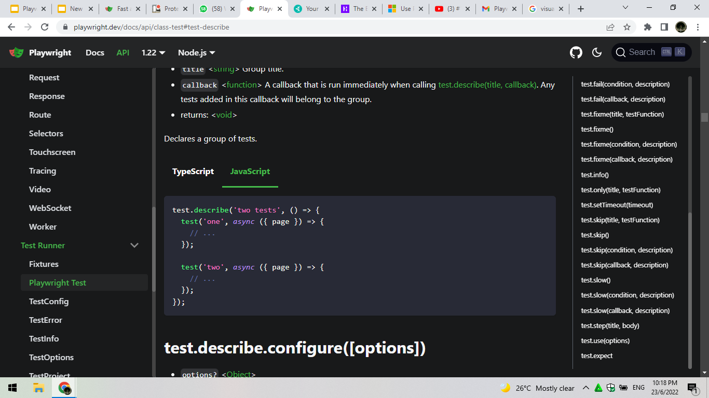
/Test Callback
Declares a group of test
test(title, testCallBack)
INDEX.HTML

Slide 28
/Selectors & Actions
Locators are used to perform actions on the elements by means of methods such as locator.click([options]), locator.fill(value[, options]) and alike.
INDEX.HTML

Slide 29
/Selectors & Actions
a) locator(CSS Selector).fill[value,options])
await page.locator('#searchSystemUser_userName').fill(VALID_USER);
b) locator(text selector).click(options)
await page.locator('text=Search').click();
c) locator(xpath).check(options)
await page.locator('xpath=//a[text()=' +'"'+ JobDesc +'"]//preceding::input[1]').check();
INDEX.HTML

Slide 30
/Assertions
When you're writing tests, you often need to check that values meet certain conditions.
Playwright Test uses expect library for test assertions. This library provides a lot of matchers like toEqual, toContain,toMatch and many more
INDEX.HTML

Slide 31
/Assertions
a) expect(locator).toHaveText(expected[,options])
await expect(page.locator('td[colspan="5"]')).toHaveText('No Records Found’);
b) expect(locator).toBeVissible(options)
await expect(page.locator('text=Successfully Saved Close')).toBeVisible();
c) expect(locator).toHaveURL(options)
await expect(page).toHaveURL('https://opensource-demo.orangehrmlive.com/index.php/attendance/viewAttendanceRecord');
INDEX.HTML

Slide 32
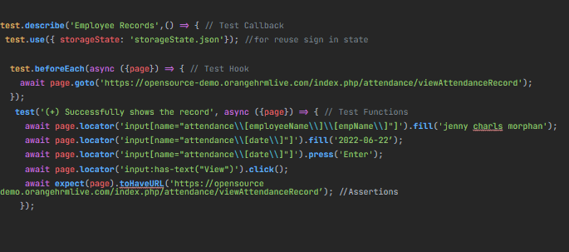
INDEX.HTML

Slide 33
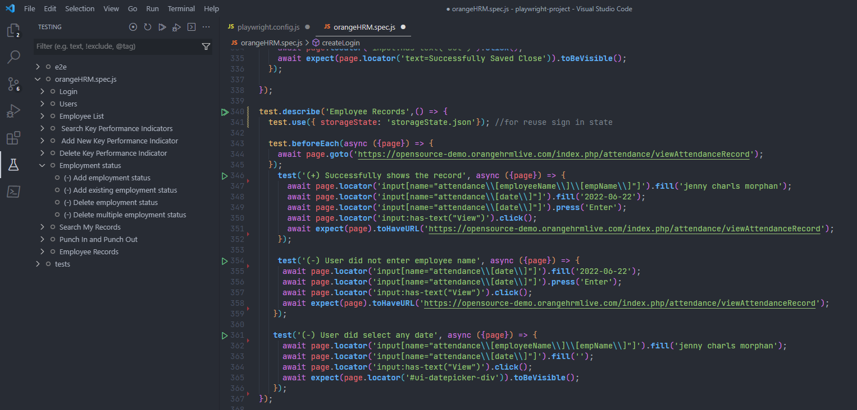
INDEX.HTML

Slide 34
/03
/Test Cases
INDEX.HTML

Slide 35
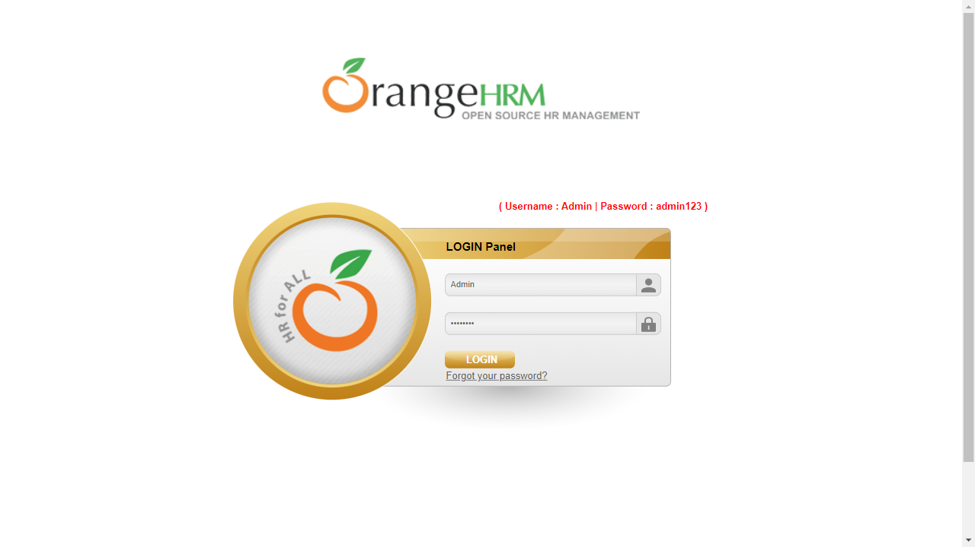
/Login
INDEX.HTML

Slide 36
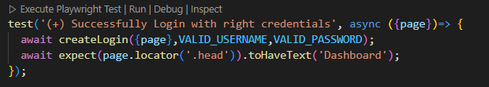
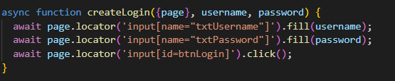
Coding used for Login function
INDEX.HTML

Slide 37
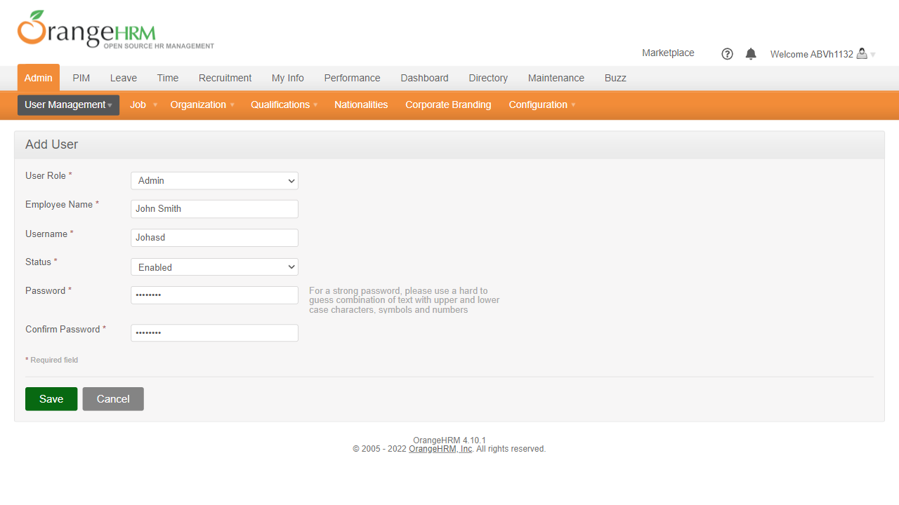
/Add User
INDEX.HTML

Slide 38
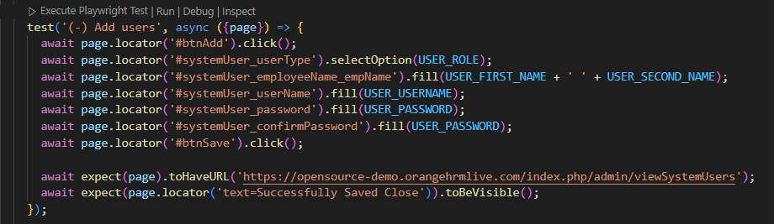
Coding used for Add User function
INDEX.HTML

Slide 39
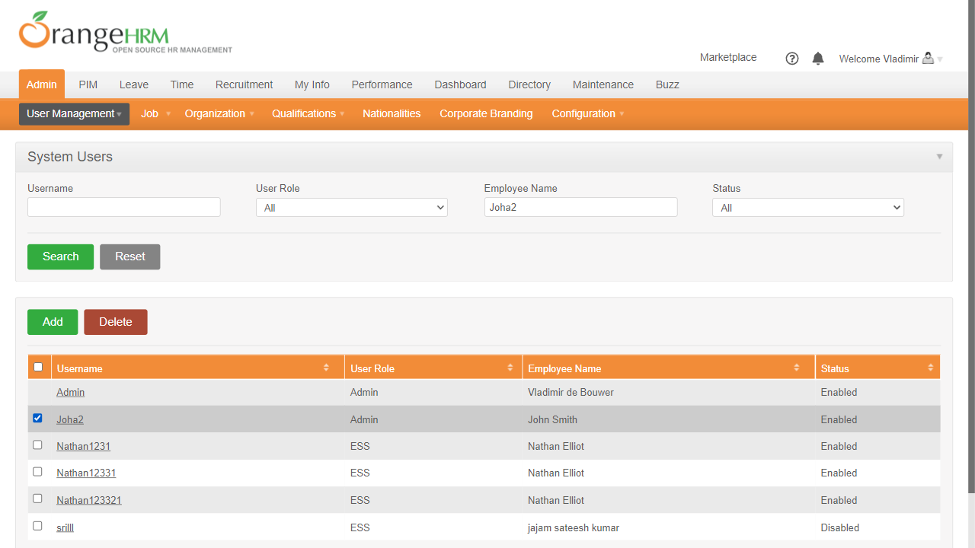
/Delete User
INDEX.HTML

Slide 40
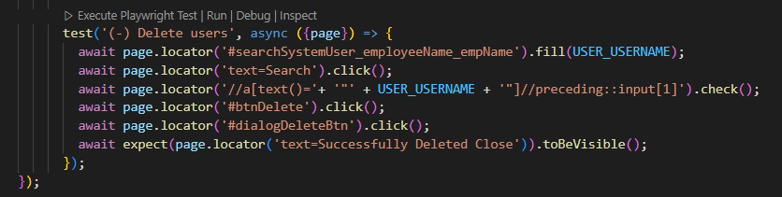
Coding used for Delete User function
INDEX.HTML

Slide 41
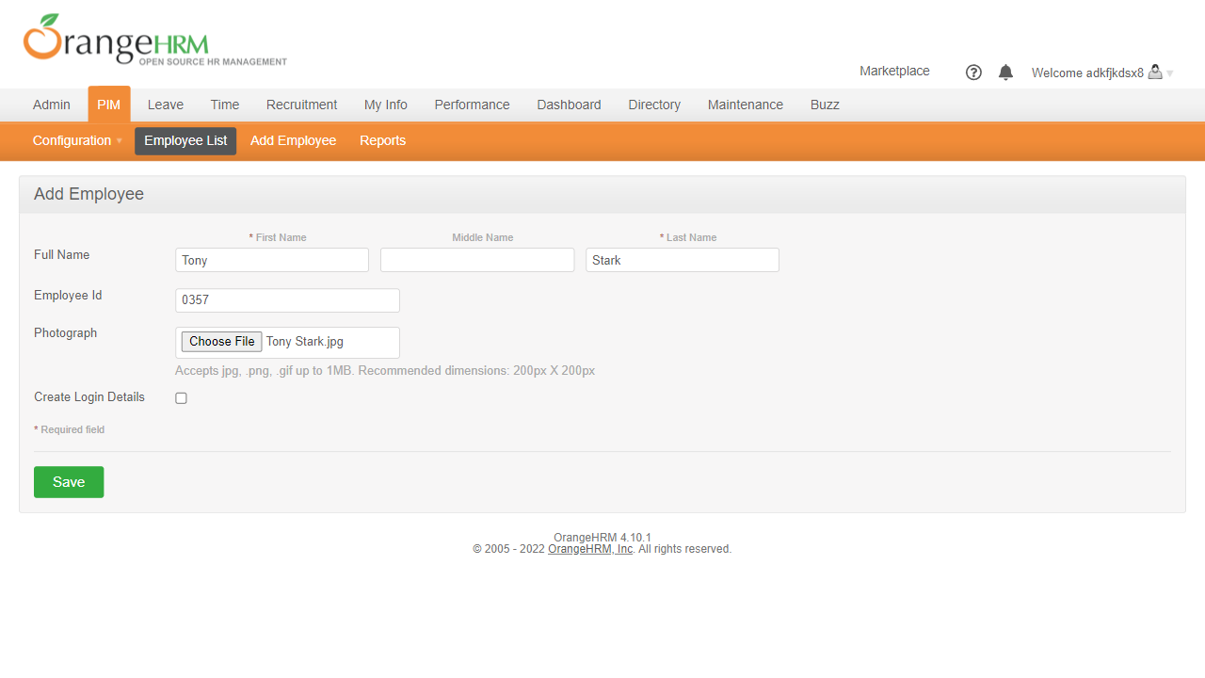
/Add Employee
INDEX.HTML

Slide 42
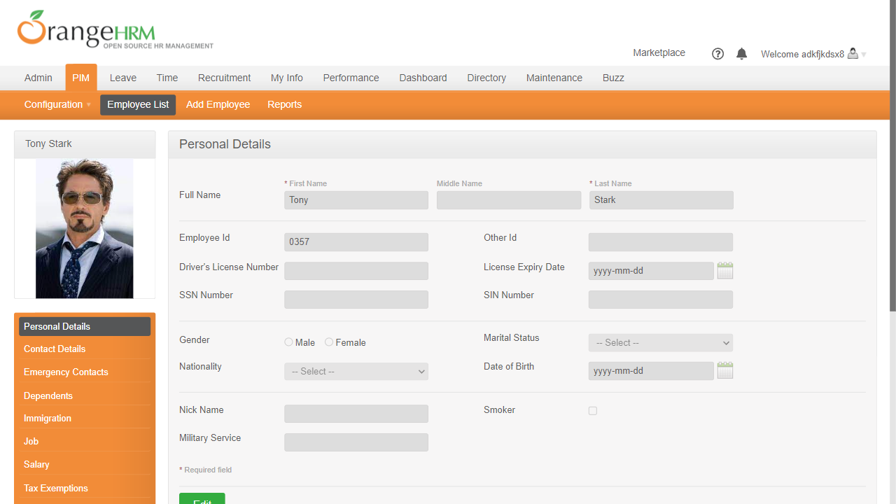
/Add Employee
INDEX.HTML

Slide 43
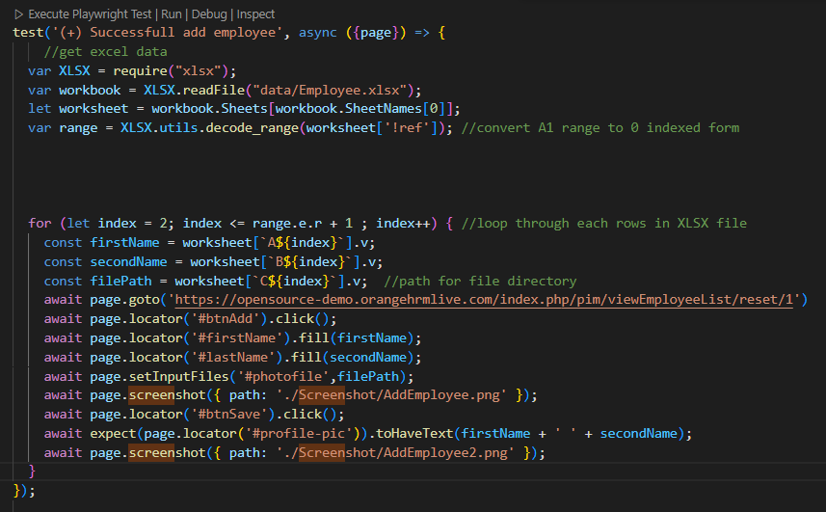
Coding used for Add Employee function
INDEX.HTML

Slide 44
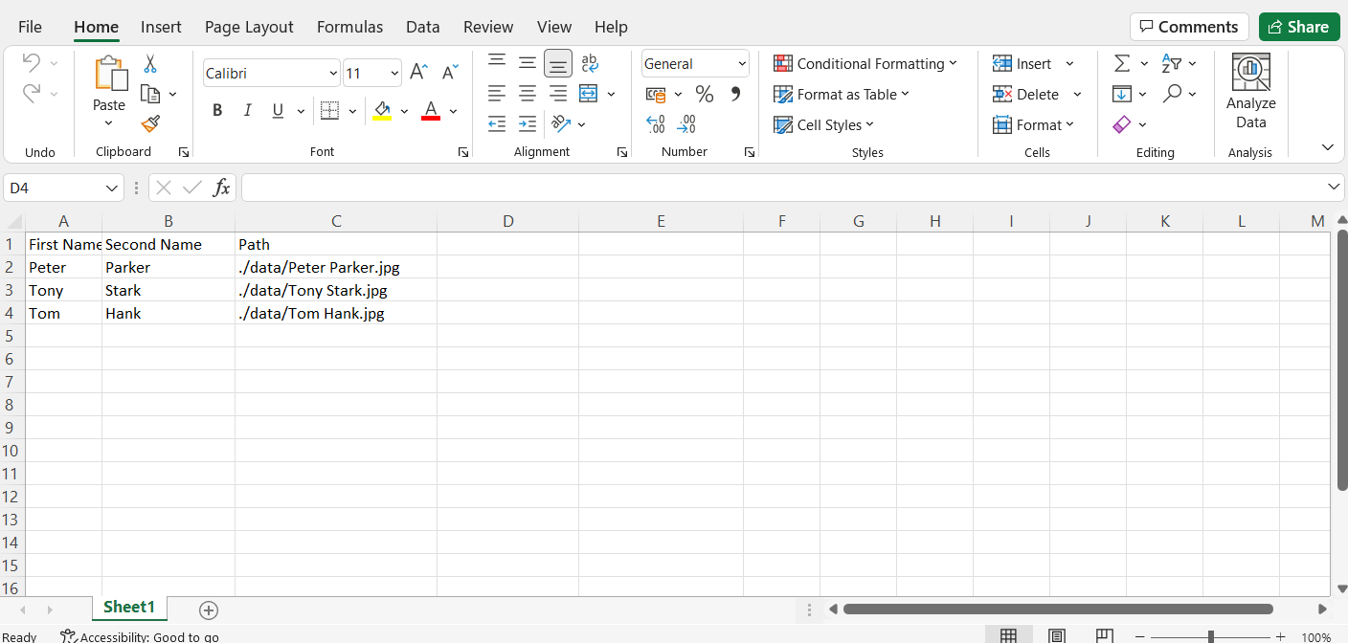
Data Driven used for Add Employee function
INDEX.HTML

Slide 45
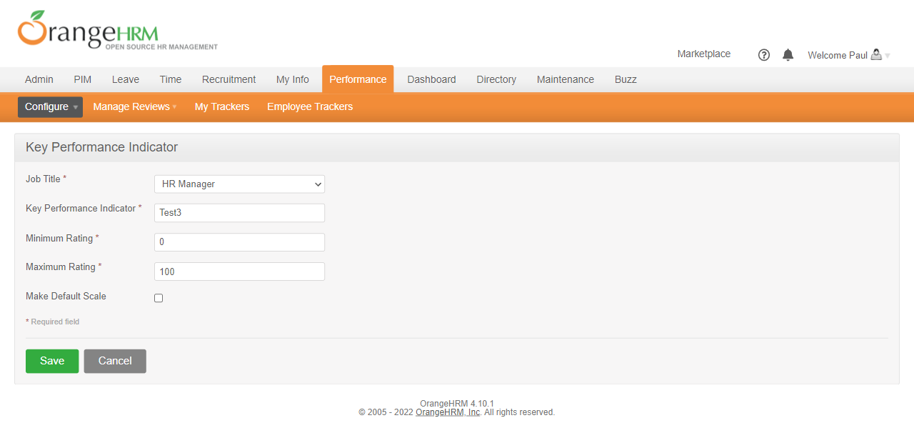
Add Key Performance Indicator (KPI)
INDEX.HTML

Slide 46
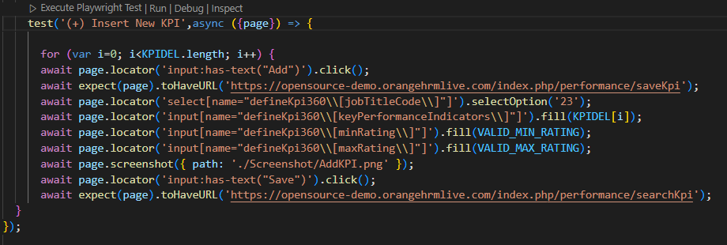
Coding used for Add KPI function
INDEX.HTML

Slide 47
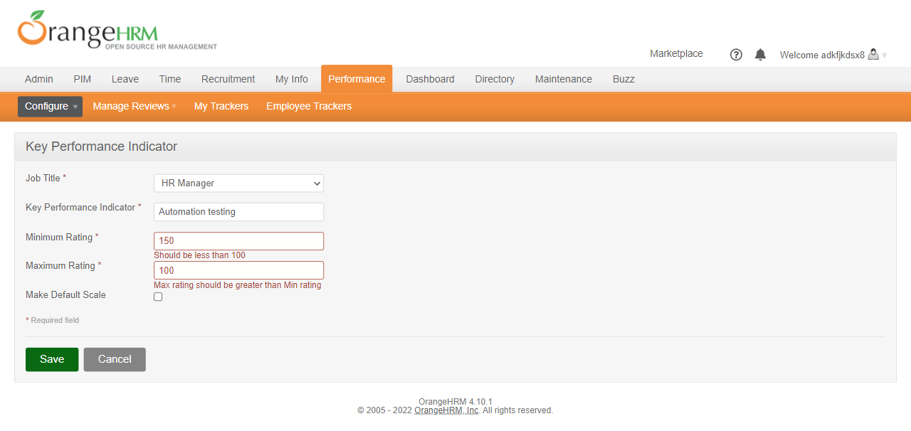
Add invalid Key Performance Indicator (KPI)
INDEX.HTML

Slide 48
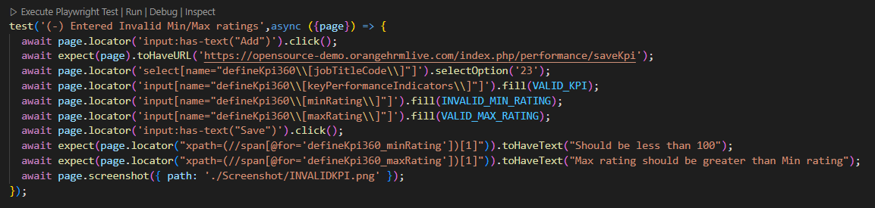
Coding used for Add Invalid KPI function
INDEX.HTML

Slide 49
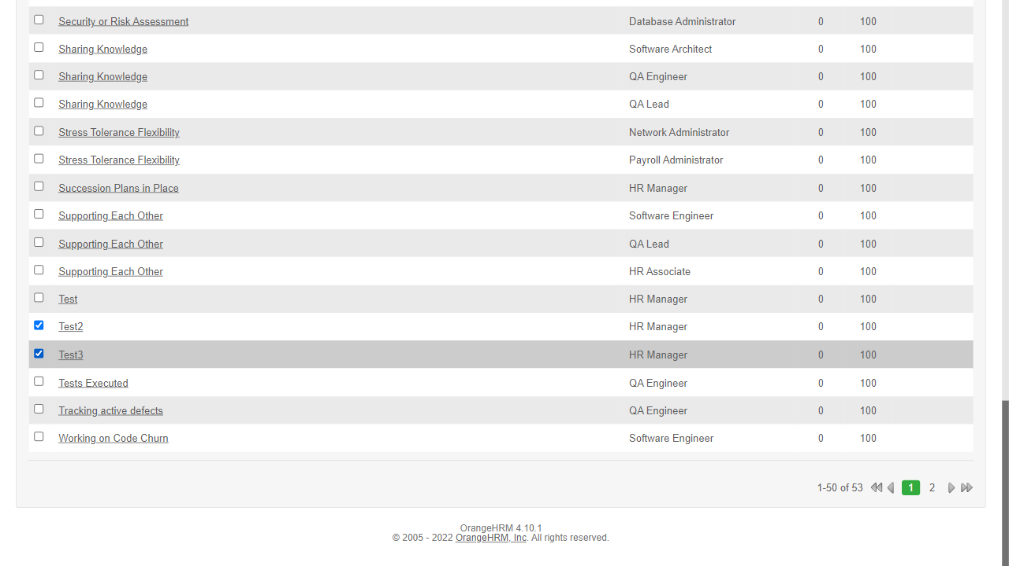
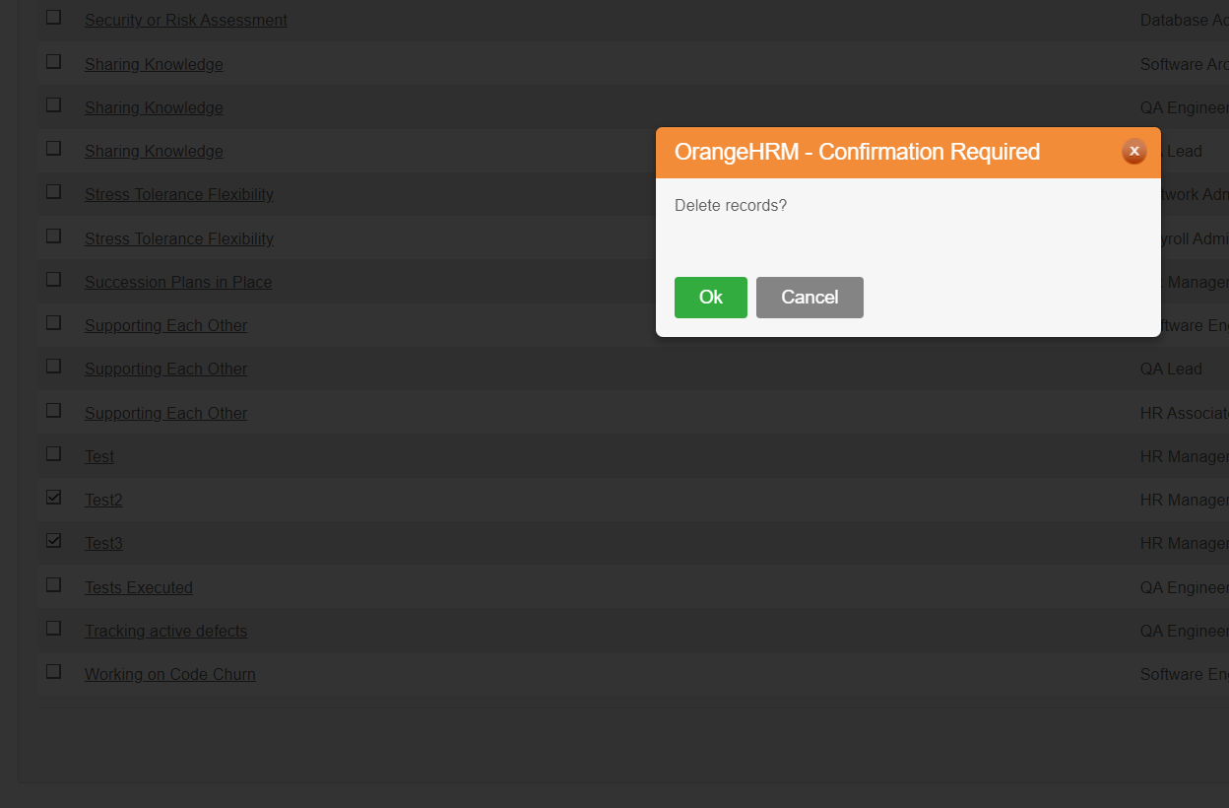
Delete Multiple KPI function
INDEX.HTML

Slide 50
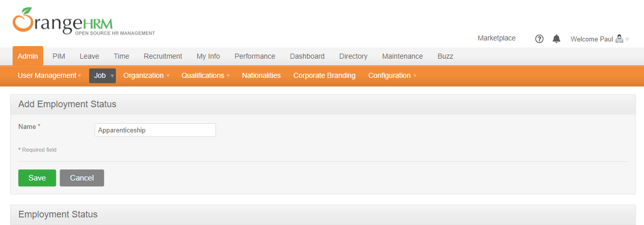
Add Employment Status
INDEX.HTML

Slide 51
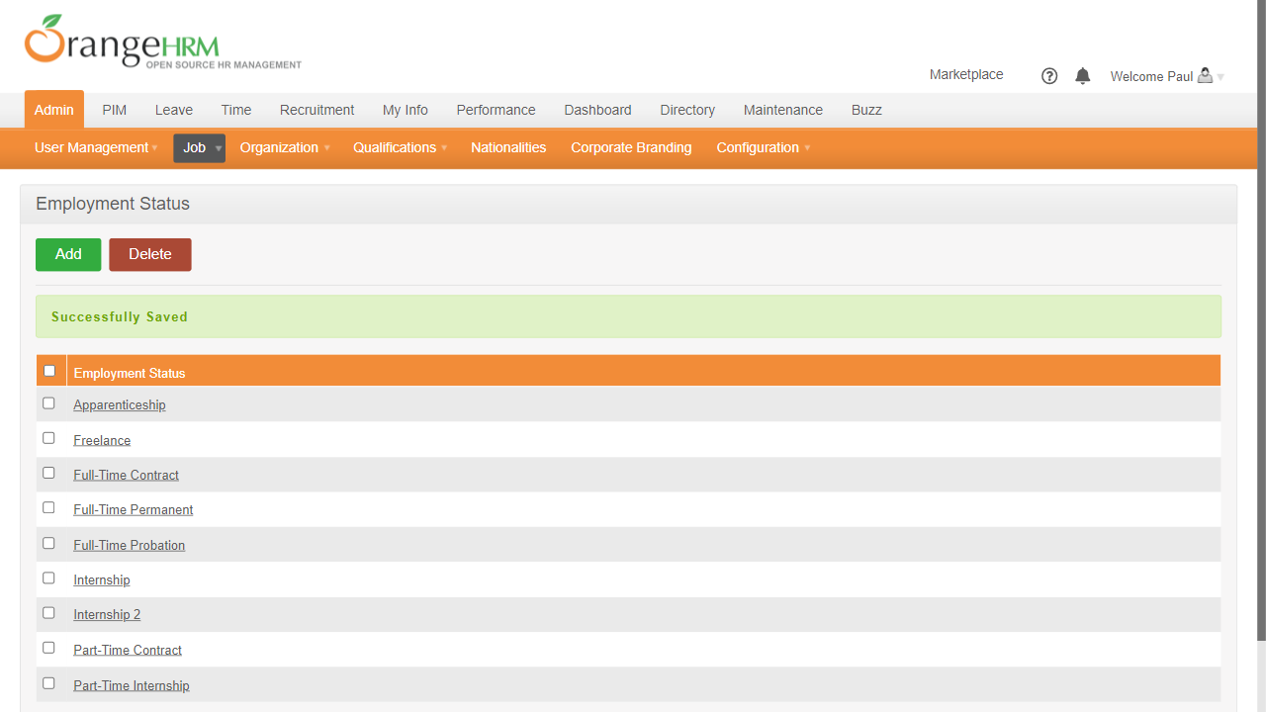
Add Employment Status
INDEX.HTML

Slide 52
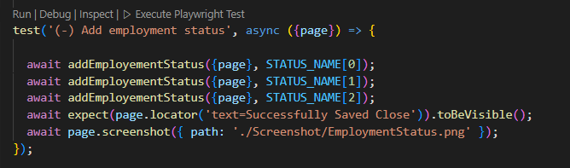
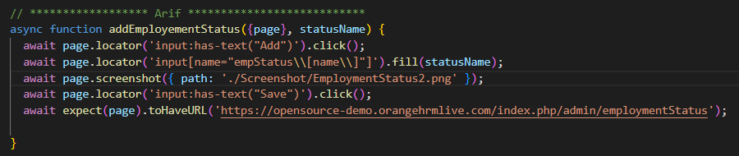
Coding used for Add Employment Status function
INDEX.HTML

Slide 53
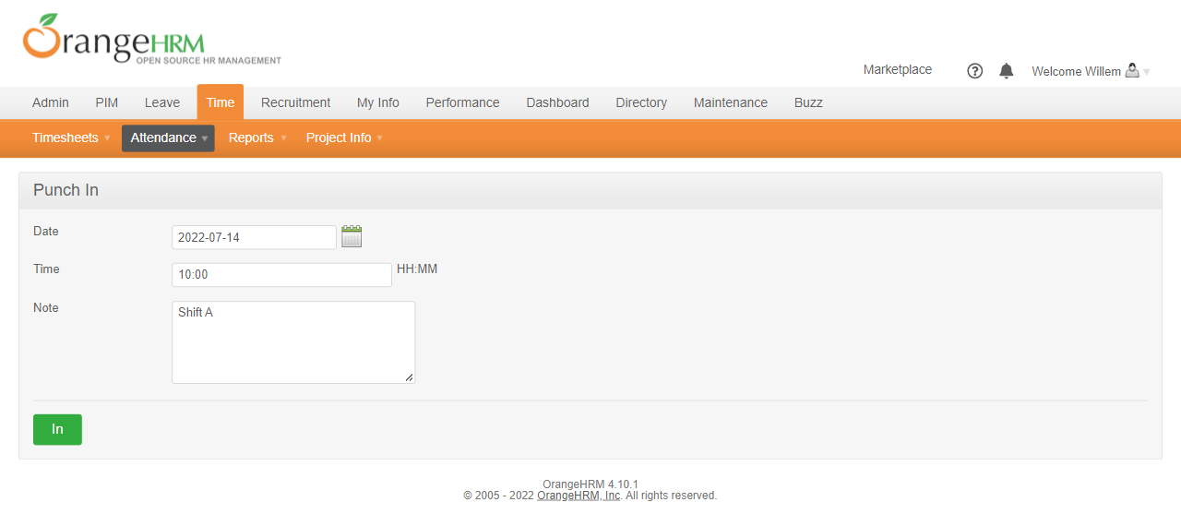
Punch In Attendance
INDEX.HTML

Slide 54
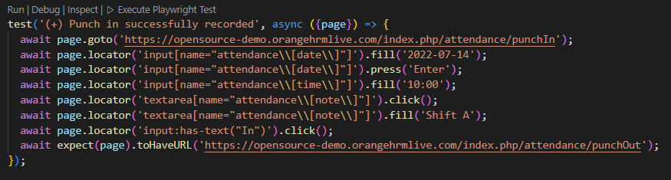
Coding used for Punch In Attendance function
INDEX.HTML

Slide 55
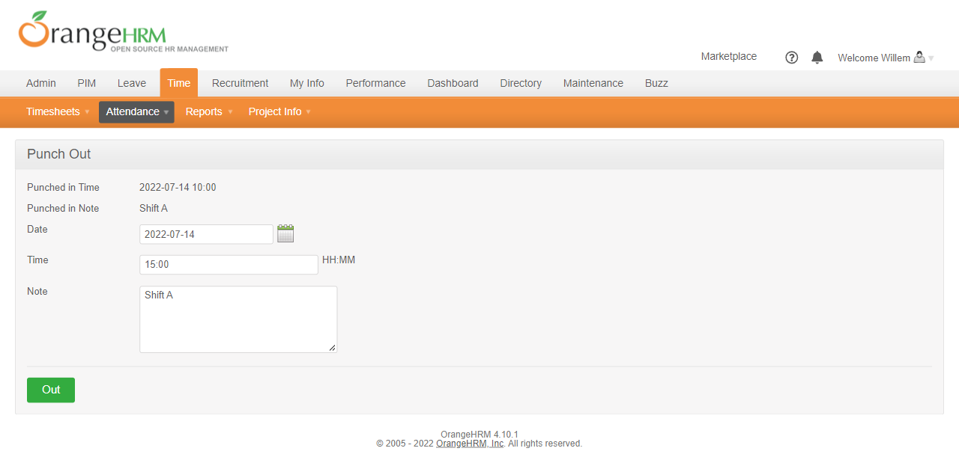
Punch Out Attendance
INDEX.HTML

Slide 56
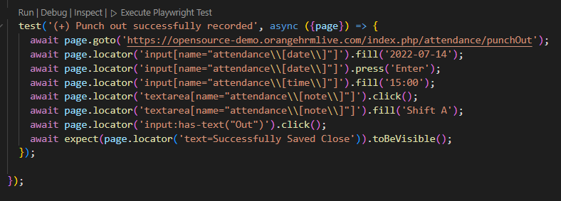
Coding used for Punch Out Attendance function
INDEX.HTML

Slide 57
/04
/Reports
INDEX.HTML

Slide 58

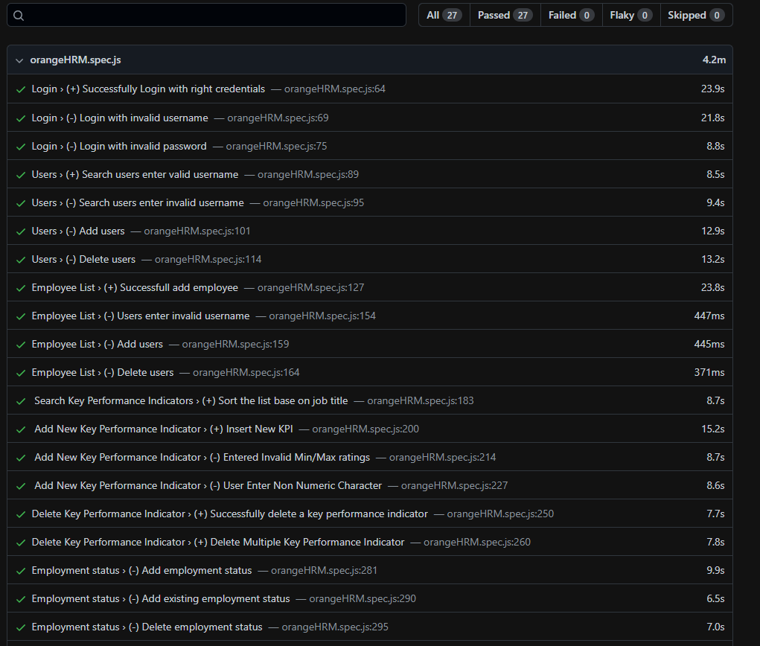
/Example of Successful Test Cases
INDEX.HTML

Slide 59
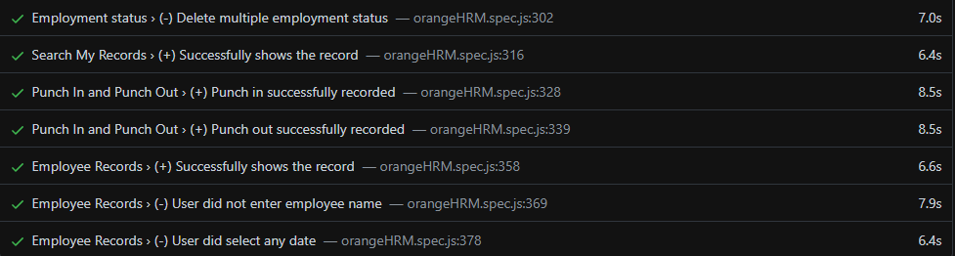
/Example of Successful Test Cases
INDEX.HTML

Slide 60
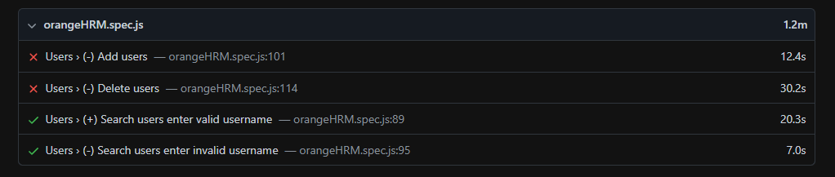
/Example of Failed Test Cases
INDEX.HTML

Slide 61
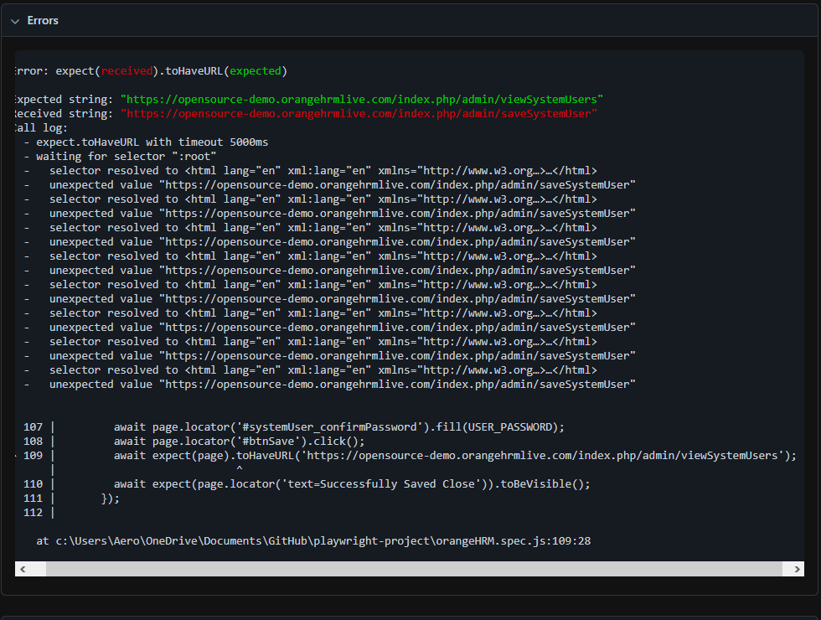
/Detailed of Errors
INDEX.HTML

Slide 62
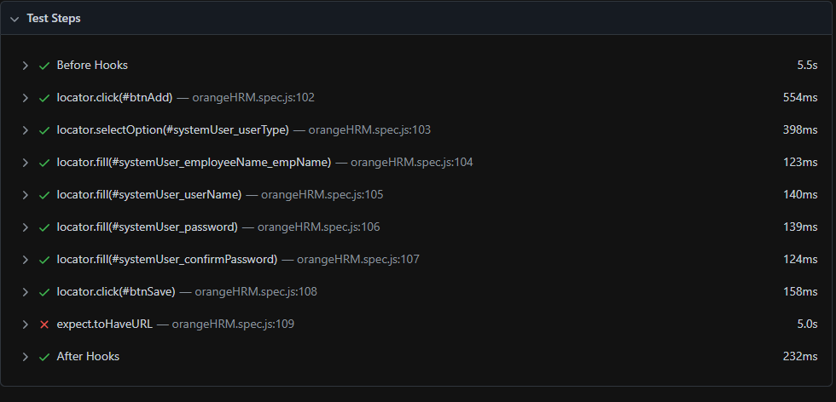
/Detailed of Errors
INDEX.HTML

Slide 63
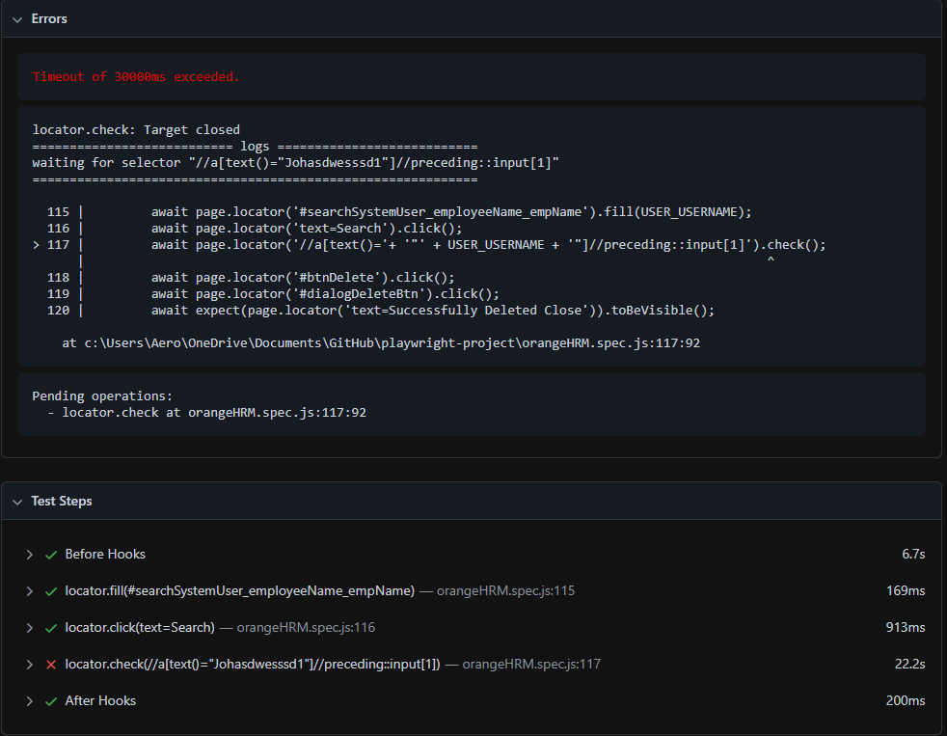
/Detailed of Errors
INDEX.HTML

Slide 64
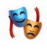
<ThankYou!>
Any question?
INDEX.HTML

